Slide 1


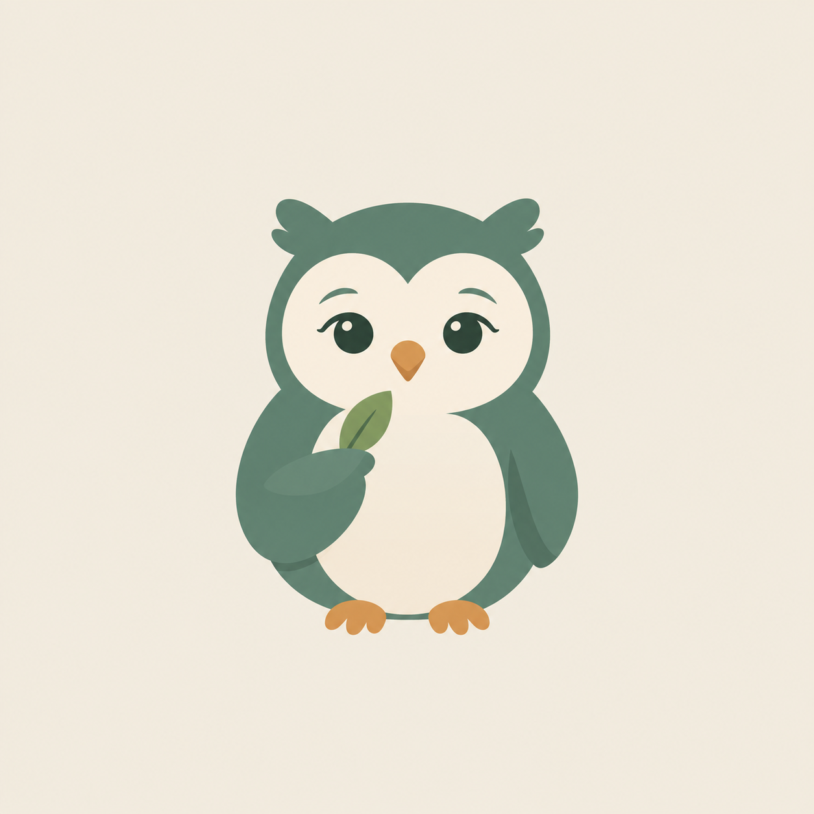
SDG 3 · GOOD HEALTH & WELL-BEING · BUILT IN N8N
Hio
A mental health companion on Telegram, for the weeks when everything is too much.
Majed - Lucas - Sofiia
Notes:
Open with the one line: Hio is a companion that lives where people already are, and helps on the days that are too full.

Slide 2
THE PROBLEM
Knowing what helps is easy. Doing it on a bad day is not.
Structure goes first
Nobody notices
Apps ask too much
When things get heavy, planning is the thing people stop doing, right when they need it most.
A week with no breaks, no sleep and no friends looks the same from the inside as any other week.
Another app to open, another form to fill. The effort lands exactly where the energy isn't.
Hio · SDG 3
Notes:
Three reasons existing tools fail the people who need them. The third one is why Hio lives in Telegram rather than being an app.

Slide 3
WHO IT IS FOR
Students in Dutch higher education, and this is not a small group
44%
12%
1 in 3
report anxiety or depression symptoms
have severe psychological complaints
with complaints get no advice or help
RIVM / Trimbos, 2023
RIVM / Trimbos, 2021
RIVM / Trimbos, 2025
Built for
Not built for
Students and young workers with anxiety, stress, low mood, poor sleep or loneliness, whose structure slips first when a week gets heavy.
People in crisis or under clinical treatment, children, and anyone who needs therapy rather than structure. The support routes are Dutch.
Monitor Mentale gezondheid en Middelengebruik Studenten hbo en wo · rivm.nl
Notes:
Lead with the numbers. The third is the gap Hio sits in: most students with complaints do get help, but a third get nothing, and Hio is the everyday support in between.

Slide 4
WHY SDG 3
Good Health and Well-being includes the mind
Target 3.4 calls for promoting mental health and well-being. Hio works on the prevention side: small daily habits, structure, reflection, and one clear route to real help when it stops being a small thing.
Notes:
Target 3.4 explicitly names mental health. Our angle is prevention, and the handover is the part that keeps it honest.

Slide 5
WHAT HIO DOES
Five things, all inside one chat
Talks
Plans
Reflects
Remembers, replies in their language, sounds like a friend and not an assistant.
Reads the calendar, adds study blocks, breaks and deadlines, keeps tasks in two lists.
A quote, an everyday example, one question. By text, or all at once for a voice note.
Checks in
Looks back
Hands over
Mornings, their own chosen hour, and after days of silence. Never nagging.
A Sunday board: habits, what they wrote, and the week ahead with weather and schedule.
Every message is checked for risk first. When it appears, Hio stops helping and points to 113.
Text or voice · any language · nothing to install
Notes:
Five capabilities plus the boundary. The last card is the one to linger on.

Slide 6
WHAT MAKES IT A WELLBEING TOOL
Four decisions that separate Hio from a productivity bot
Help them do less
No streaks, no scores
Hio protects breaks and sleep, and flags a brutal week. It never praises overworking.
For an anxious user, a broken streak is one more failure. A skipped day is just a day.
Decide, don't ask
Their words, not ours
Every question is friction. Hio picks the list, the time and the length itself.
Users pick their own struggles and habits, in their own words. Hio never diagnoses.
Hio · design principles
Notes:
This is the slide that answers "why is this mental health and not just automation".

Slide 7
UNDER THE HOOD
One workflow, two triggers
Reactive · a message arrives
Telegram trigger, then voice transcription if needed, find the user, crisis check, then either onboarding or the Hio agent with its tools, and the reply is split into short bubbles.
Proactive · every hour
Read the users, work out who is due, read their calendar, add weather, journal history and nearby places, write the message, and on Sunday build and send the weekly board.
Claude Haiku 4.5
Whisper
Google Calendar, Tasks, Sheets
Open-Meteo
OpenStreetMap
Tavily web search
Around 40 nodes · 4 AI nodes · 10 agent tools
Notes:
Two triggers in one workflow. Mention that the AI decides which tools to call, rather than the flow being hard-wired.

Slide 8
THE BRIEF
How Hio meets it
✓
6+ connected nodes
Around 40, across two branches
✓
At least one AI node
Four, plus Whisper for voice
✓
Runs automatically
Messages, and an hourly schedule
✓
A real SDG 3 need
Overwhelm, isolation, lost structure
✓
Working, not a mock-up
Live bot, real calendar, real entries
Hio · built in n8n
Notes:
Tick each one off quickly. The last row is the one that matters, so pause there and go into the demo.

Slide 9
DEMO
A heavy week, handled
A new user says hi, and Hio sets them up in conversation
"add gym sat 3pm" lands in the real calendar, and a clash gets caught
A voice note becomes a journal entry, opened with a quote
A check-in arrives without anyone asking for it
A worrying message stops everything and hands over to 113
Telegram : @hoinibot
Notes:
Keep the crisis step for last so it is the thing they remember.

Slide 10
ETHICAL REFLECTION
Three risks we can name honestly
Privacy
Dependency
Accountability
Hio holds what someone wrote at 3am, their calendar, their habits. More revealing than a medical file, because it covers what they did and how they felt about it. Here it sits in a Google Sheet, and every conversation is logged in plain text.
We made Hio warm, funny and awake at any hour. For someone isolated, that is exactly the risk. Easier than people is not better than people, and it has no real understanding of them.
While building this, Hio told me a task was ticked off. It wasn't, and it said so twice, with full confidence. Harmless here. Scale that to "you seem better this week" and nobody is responsible.
Health data under the GDPR · fine for a prototype, not for a real user
Notes:
The third card is a real thing that happened during the build. Tell it as a story, it lands harder than an abstract risk.

Slide 11

WHERE AUTOMATION STOPS
The moment risk appears, Hio stops being useful
Every message is classified before anything else runs, at temperature zero so the same message always gets the same verdict
Hio says plainly that it is an AI and cannot give what is needed, then hands over to 113
Tuned to over-trigger, because a false alarm costs far less than a missed one
The crisis numbers are written into the workflow, not generated by the model. If the AI fails completely, they still go out unchanged. Hio does not coach, assess or try to talk anyone down.
Would I trust it for my own health? For planning and journaling, yes. For a crisis, never on its own.
Notes:
Answer the brief's question directly here: where does automation stop, and would you trust it.

Slide 12

Thank you
A companion for ordinary days, with a clear exit to humans for the days that are not.
Questions?
Majed Al-Sakkaf · SDG 3 · n8n
Notes:
Close on the one-line description, then take questions.

